Slide 1
Category review: Chips
June 2023
Retail Analytics Report

Slide 2
Executive summary
High-level findings and key callouts
01
Chips Category Review
Sales have mainly been due to Budget - older families, Mainstream - young singles/couples, and Mainstream - retirees shoppers.
The sales can be further improved in the two Mainstream - young singles/couples and Mainstream - retirees shoppers segments.
Overall, we suggest an emphasis on the Mainstream - young singles/couples.
Added visibility of Tyrrells chips near store areas that this target segment tends to visit the most would likely increase purchases driving sales growth.
02
Trial Assessment
The results for trial stores 77 during the trial period show a significant difference in at least two of the three trial months for both the total sales and number of customers metrics.
Trial store 86 saw a statistically significant increase in customers but not total sales.
Trial store 88 saw a statistically significant increase in sales but not customers.

Slide 3
01
Chips Category Review

Slide 4
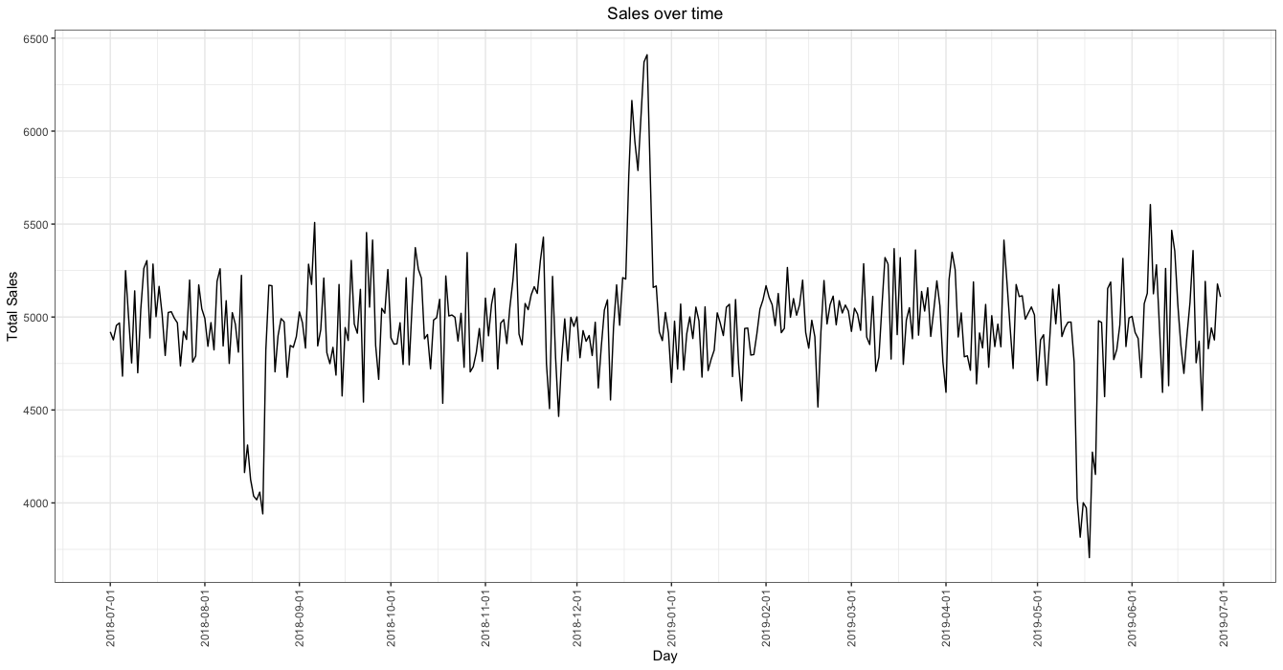
Overview: Two dips of sales in 8/2018 and 5/2019 over the last 52 weeks
Notes:
key callout for the chips category
fix the line chart to be weekly sales count instead of daily sales count
The total of Chips sales has remained relatively consistent within the $4500-$5500 range over the last 52wks; two notable dips in sales occurred in 8/2018 and 9/2019

Slide 5
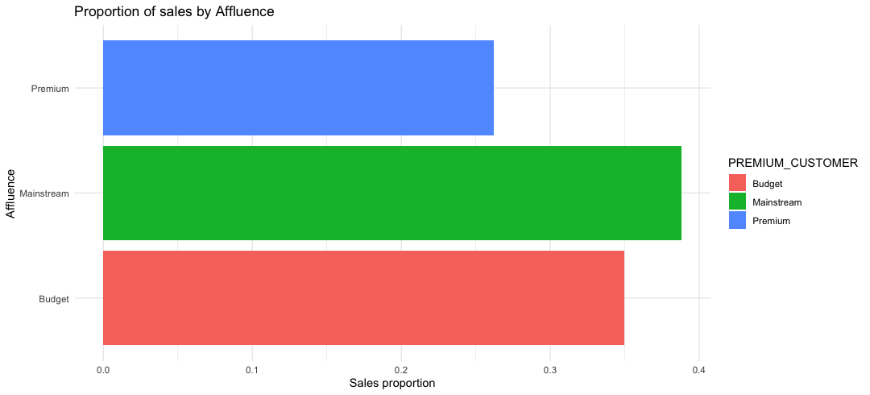
Affluence and its effect on sales
Notes:
‘affluence’ refers to ‘PREMIUM_CUSTOMER’ column in data set
This slide will be commentary on affluence and its effect on sales for the category of chips

Slide 6
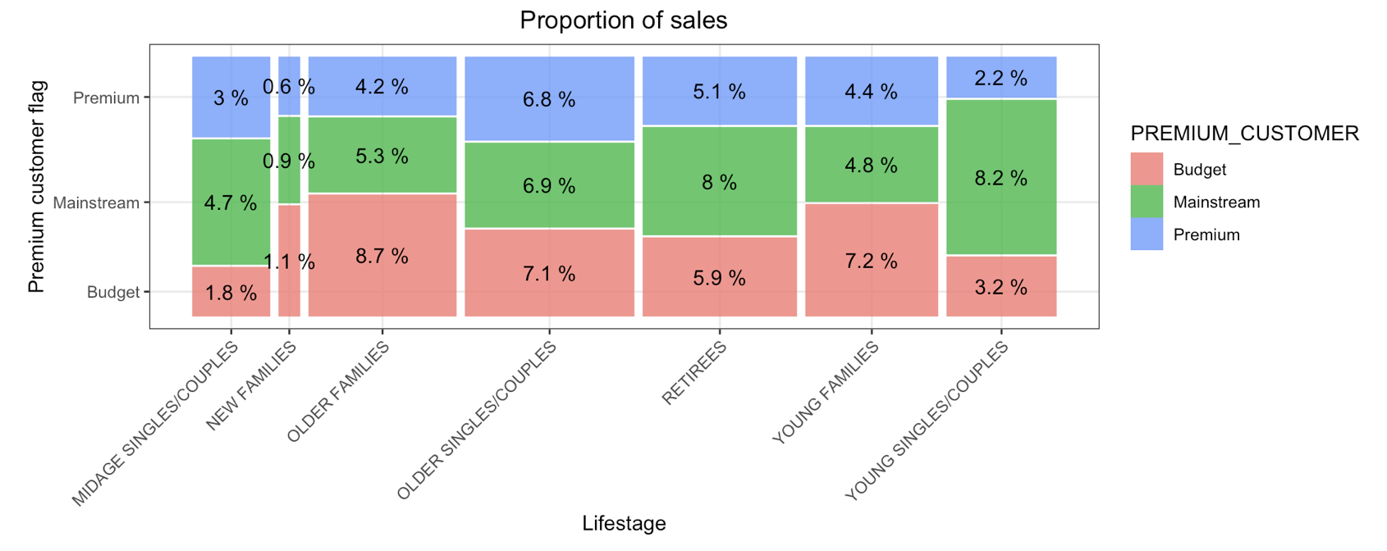
Affluence, Life stage and their effect on sales

Slide 7
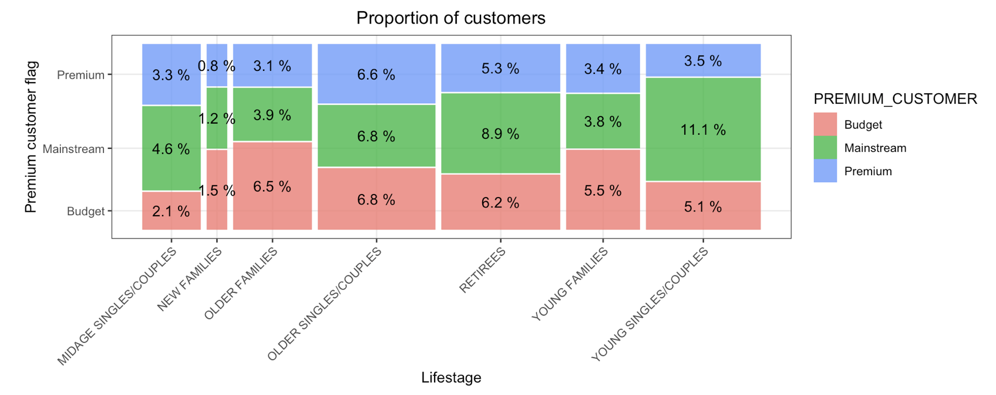
Proportion of customers by Affluence and Life stage
Notes:
Stretch: Try visualising the proportion of customers by affluence and life stage on this slide
leave a note on the slideproportion is relative to the overall total number of customers in the data set

Slide 8
02
Trial store performance

Slide 9
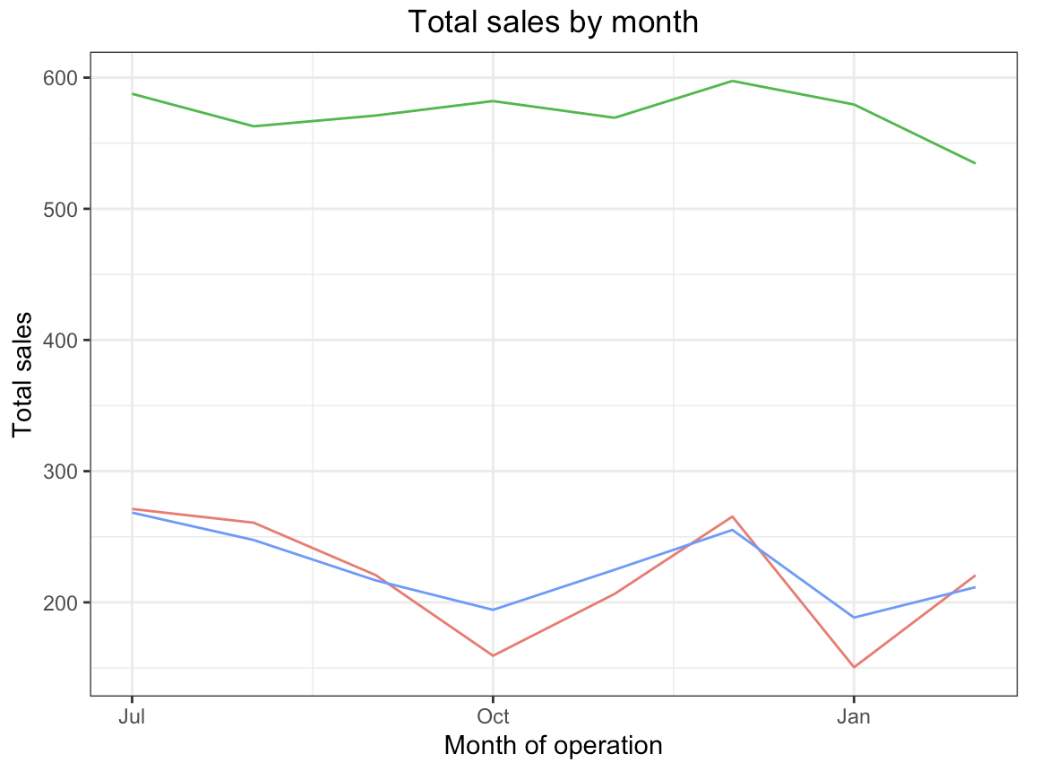
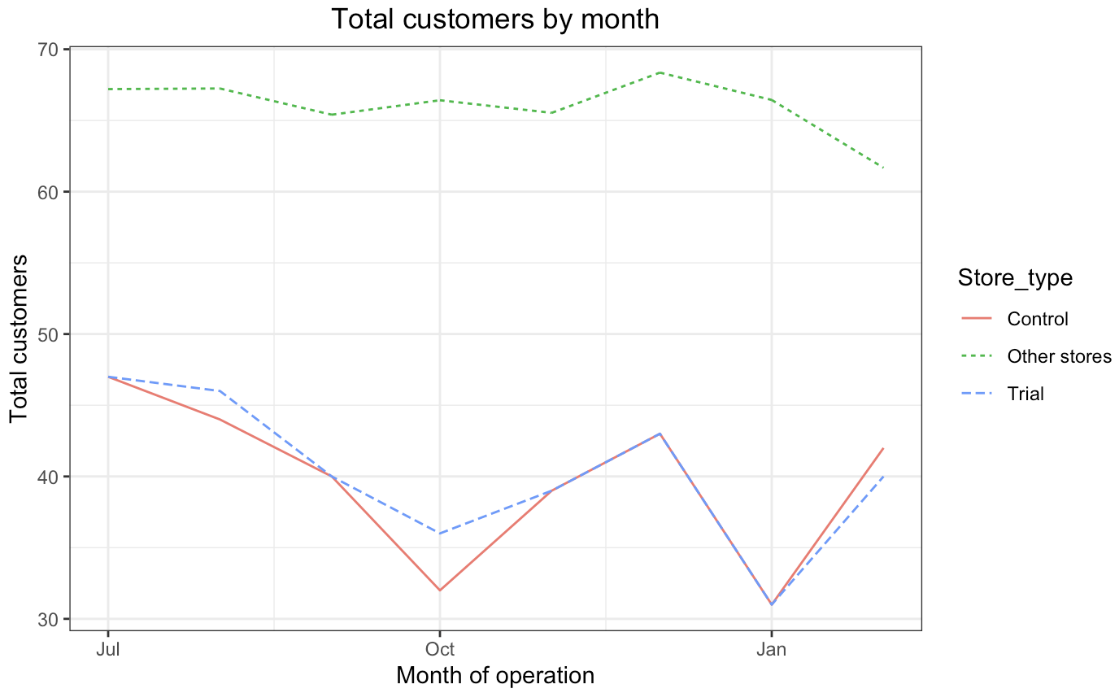
Control stores are selected based on how similar monthly total sales in dollar amounts and monthly number of customers are to the trial stores
Control store 233 for trial store 77
Control store 155 for trial store 86
Control store 237 for trial store 88
Similarities between control store 233 and trial store 77 vs other stores.

Slide 10
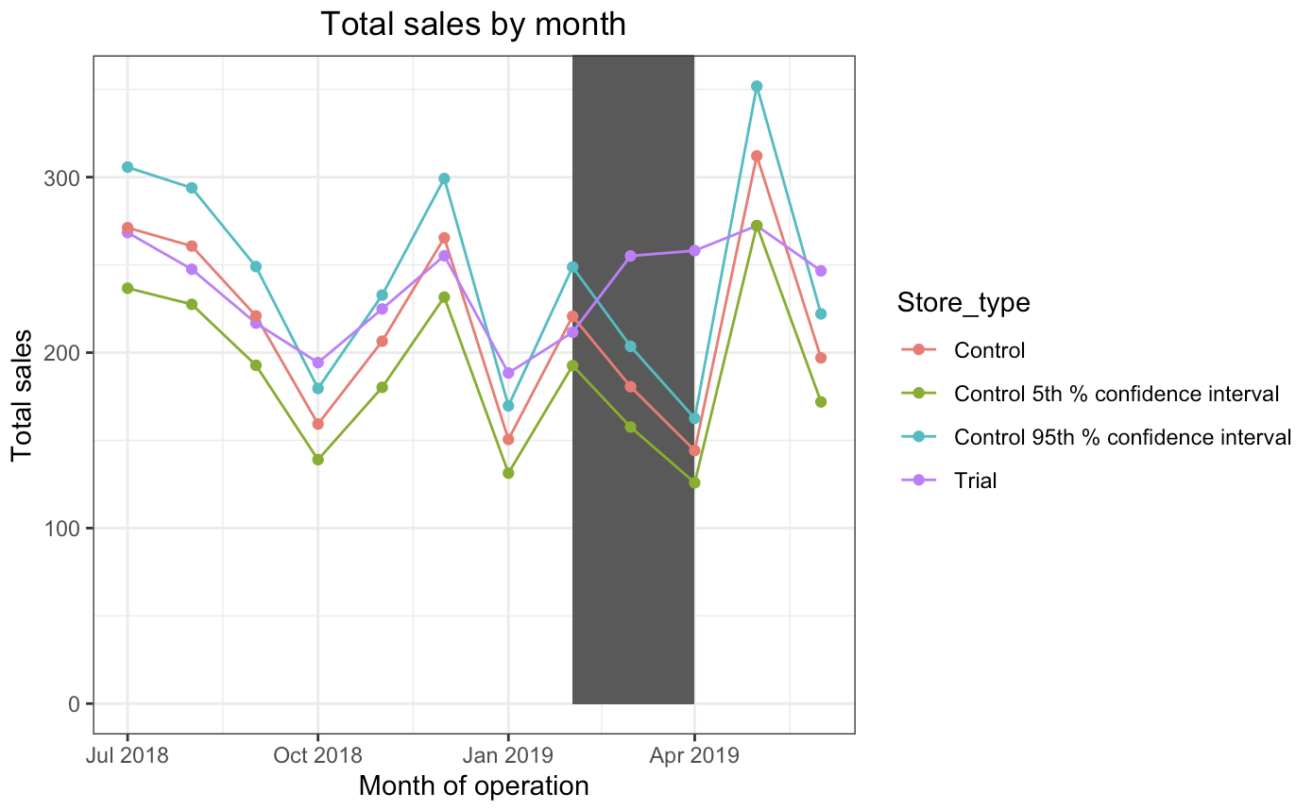
Sales performance in the trial store 77
Notes:
brief description of the chart at the top

Slide 11
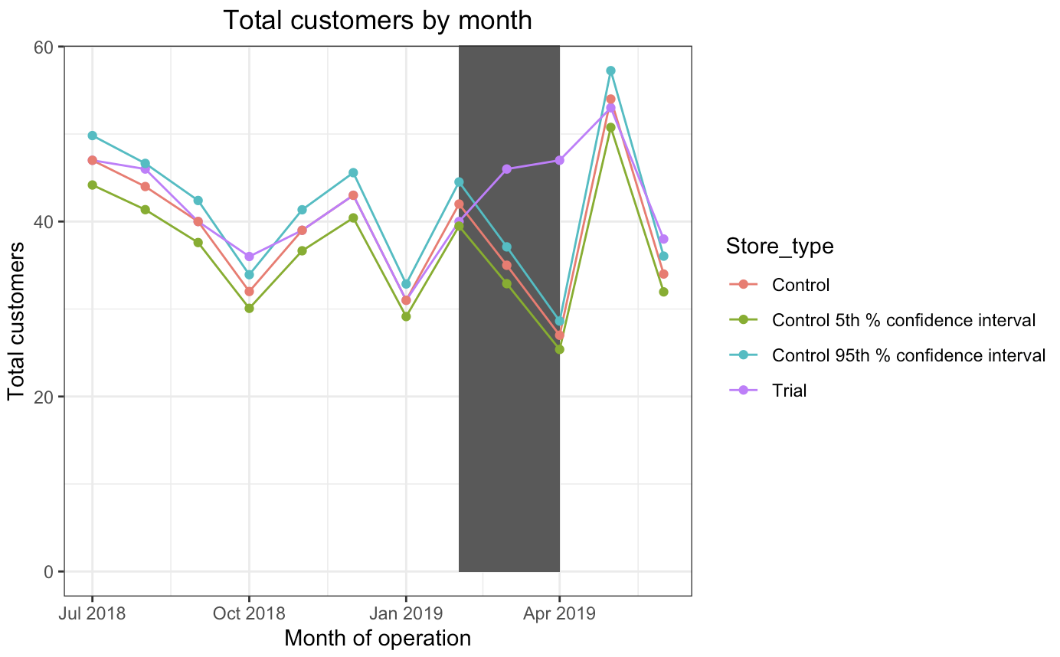
Customers performance in the trial store 77

Slide 12
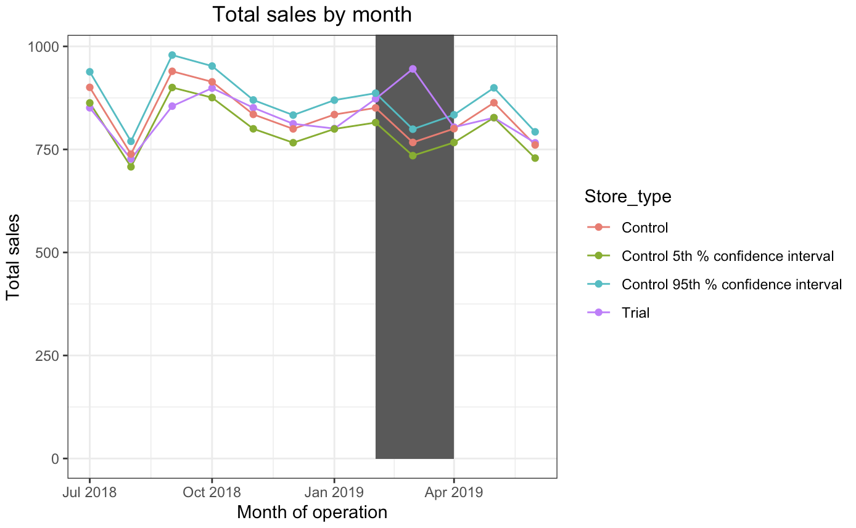
Sales performance in the trial store 86

Slide 13
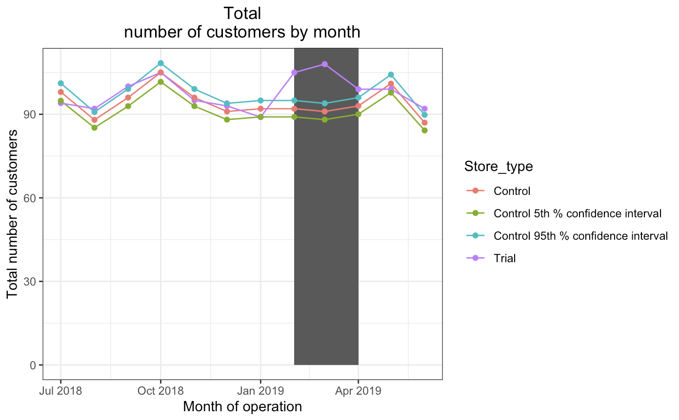
Customers performance in the trial store 86

Slide 14
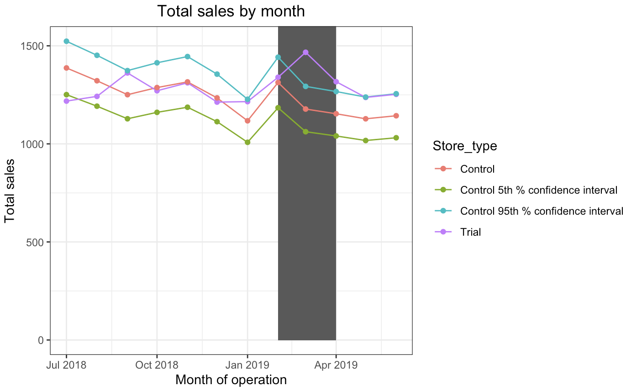
Sales performance in the trial store 88

Slide 15
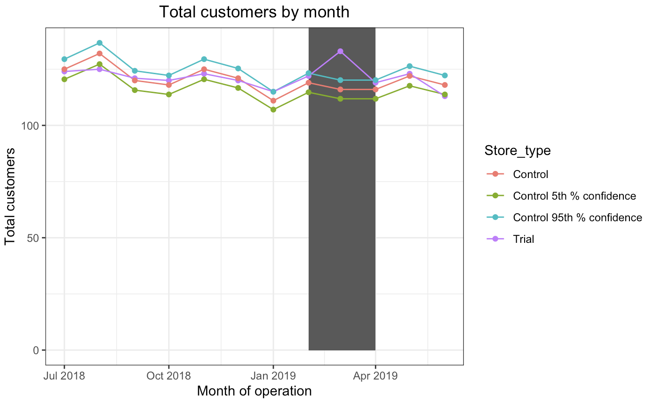
Customers performance in the trial store 88

